Slide 1

Library Management System

Slide 2
Team Members
Sarang Goel (2100290110143)
Shivam Yadav (2100290110156)
Sudhanshu Tyagi (2100290110166)

Slide 3
Introduction
Library Management System is a Binary Search Tree based program, where the books will be stored in a binary search tree based on a specific key(ex.: book title). Each node could represent a book and contains information of the book (i.e. title, author, etc).
By this software students can issue books and the admin or librarian can update/delete the record of books kept in the library.

Slide 4
Features
Librarian login
Add book
Delete book
Update book
Print all books(inorder-traversal)
User login
Issue book
Return book

Slide 5
Data Structures used
Binary Search Tree: Searching operation performs an in-order traversal on the created binary search tree to get the elements in sorted order.
Hash-Map: Unique keys are generated using hash map and assigned to every book to avoid duplication of keys.
2-D array: store the record of each book where rows indicate unique value for particular book which hash-map returns and columns indicate total quantity of books and available quantity of books.

Slide 6
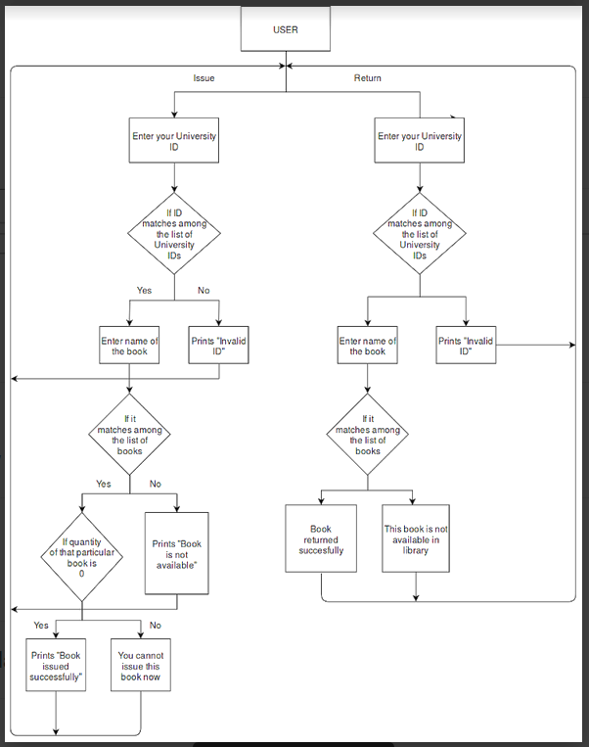
Flow Chart for User Interface

Slide 7
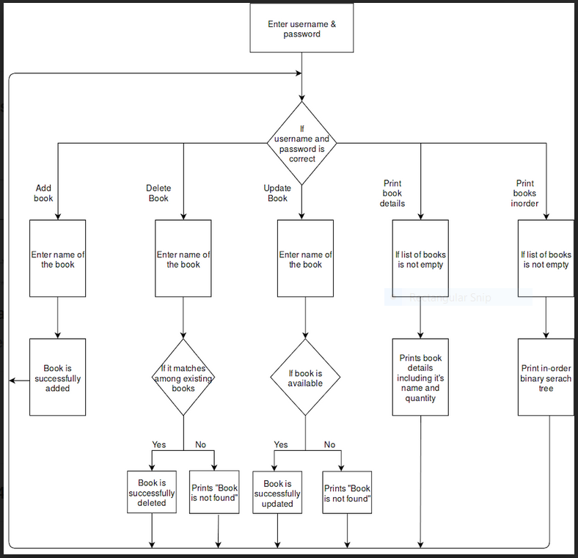
Flow Chart for Admin Interface

Slide 8
Thank You

